Slide 1

Lecture 2
Data Normalisation
Dr David Hamill

Slide 2

Review ERDs
Data design & Normalisation
Conclusion
Lab

Slide 3

Normalisation is the process of organizing a database into tables in such a way that the results of using the database are always unambiguous and as intended.
  Normalisation may have the effect of duplicating data within the database and often results in the creation of additional tables.
Normalisation is the process of structuring relational database schema such that most ambiguity is removed.

Slide 4

A simple example of normalizing data might consist of a table showing:
If this table is used for the purpose of keeping track of the price of items and you want to delete one of the customers, you will also delete a price.
Normalizing the data would mean understanding this and solving the problem by dividing this table into two tables, one with information about each customer and a product they bought and the second about each product and its price.
Making additions or deletions to either table would not affect the other.
        Source: http://searchsqlserver.techtarget.com/sDefinition/0,,sid87_gci212669,00.html
Customer | Item purchased | Purchase price
Thomas | Shirt | €40
Maria | Tennis shoes | €35
Evelyn | Shirt | €40
Pajaro | Trousers | €25

Slide 5

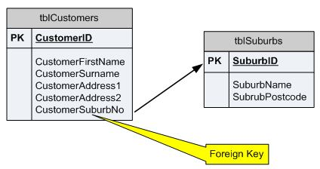
Tables = Relations
  NOT the same as Relationships in an ERD
  Rows (tuples) & columns (domains)
Attributes have Domains
  Set of all possible attributes
Primary Key
  Unique ID for each row of a table
  Simple or Compound
Foreign Key
  Is a Primary key in
  ANOTHER table

Slide 6

Unstructured = Non-first Normal Form (NF²) or Un-normalised form (UNF)
8 Normal forms
Only concerned with 3
  1NF -> 3NF
7 steps

Slide 7

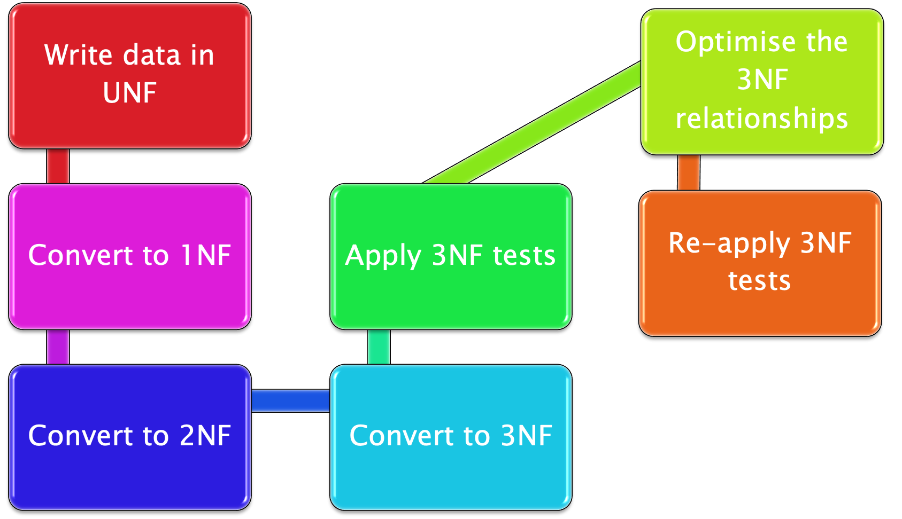
Pádraig de Burca

Slide 8

At the end:
Each Attribute in a Relation must depend on:
  the key,
  the whole key &
  nothing but the key
  So help me Codd
  Codd being Dr. Edgar Codd of IBM
  who first used set theory to
  structure data & is the father of
  the relational database

Slide 9
Write data in UNF
  List all possible columns
  Identify a primary key
    Unique
    Not null
    No repeats within row
  Underline key
  Identify & brace repeats

Slide 10
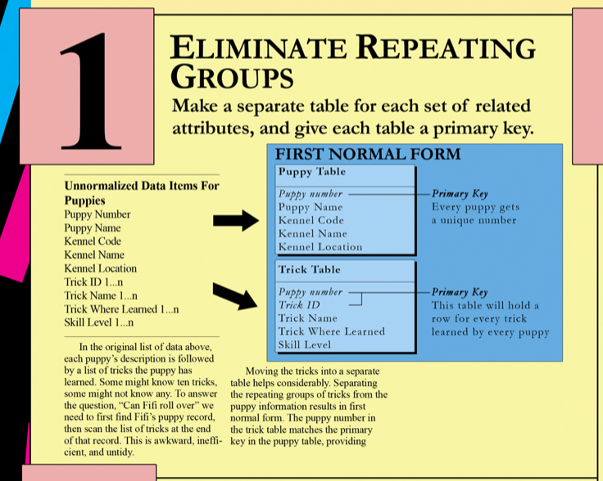
Write data in UNF
Convert to 1NF – Eliminate Repeats
  Depends on the KEY
  Remove repeating structures
  Put repeating group into new relation
  Key for new relation usually compound

Slide 11

Introduction to normalisation
http://youtu.be/ZiB-BKCzS_I
1st Normal form
http://www.youtube.com/watch?v=q3Wg2fZENK0

Slide 12
2nd Normal form
http://www.youtube.com/watch?v=vji0pfliHZI

Slide 13
Write data in UNF
Convert to 1NF
Convert to 2NF
Convert to 3NF
  Depends on NOTHING BUT THE KEY
  Remove dependencies between non-key attributes
  Is attribute A dependent on attribute B
  Or vice versa
  Generates Foreign Key

Slide 14
Write data in UNF
Convert to 1NF
Convert to 2NF
Convert to 3NF
Apply 3NF tests
  For each PK, is there ONLY 1 value for each attribute?
  Is each attribute entirely dependent on PK?
  Hold each data element in as few occurrences as possible
  Eliminate hidden dependencies

Slide 15
Write data in UNF
Convert to 1NF
Convert to 2NF
Convert to 3NF
Apply 3NF tests
Optimise 3NF relations
  Can you combine relations with the same PK?
  Order of PK attributes in compound key do NOT matter
  Check for synonyms

Slide 16
Write data in UNF
Convert to 1NF
Convert to 2NF
Convert to 3NF
Apply 3NF tests
Optimise 3NF relations
Re-apply 3NF tests
  Just in case

Slide 17
Normalisation in 6 minutes
Lecture by Dr. Art Langer - INTEGRITY
http://www.youtube.com/watch?v=ZiB-BKCzS_I

Slide 18

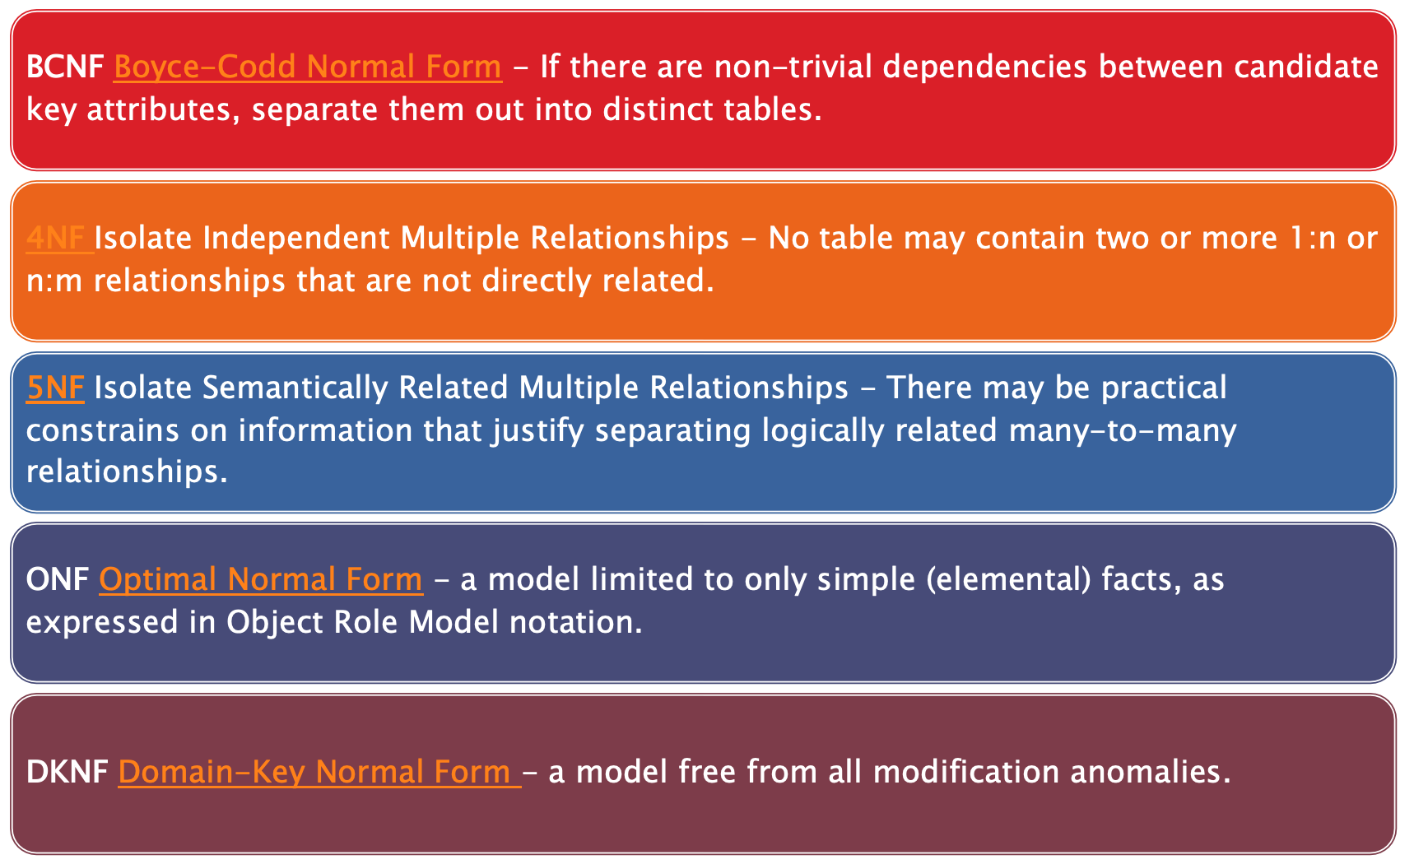

Slide 19

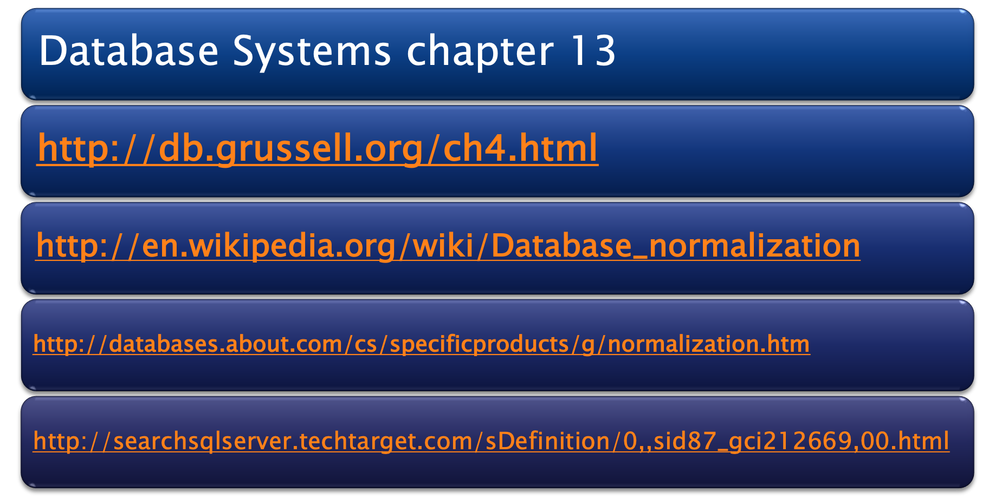
Pádraig de Burca

Slide 20

IDENTIFY ALL FIELDS REQUIRED FOR YOUR DATABASE AND LIST THESE

Slide 21

IDENTIFY A FIELD THAT COULD BE USED AS A ‘PRIMARY KEY’ – A UNIQUE IDENTIFIER.
HIGHLIGHT THIS FIELD IN RED AND WITH AN UNDERSCORE
IF YOU CANNOT FIND AN APPROPRIATE FIELD AS A PRIMARY KEY, LOOK AT COMBINING 2 X FIELDS TOGETHER – COMPOSITE OR COMPOUND KEY

Slide 22

REMOVE ANY FIELDS THAT ARE NOT DEPENDENT ON THE PRIMARY KEY AND MOVE THESE TO A NEW TABLE.
ENSURE THIS NEW TABLE INCLUDES THE LINK (FOREIGN KEY – A COPY OF THE PRIMARY KEY IN ANOTHER TABLE) BETWEEN THE TABLES.
IDENTIFY A PRIMARY KEY IN THIS NEW TABLE OR SIMPLY CREATE ONE.

Slide 23

CONTINUE TO KEEP SPLITTING YOUR DATA UP UNTIL YOU CAN ENSURE THAT DUPLICATION CANNOT HAPPEN.
PLEASE NOTE: YOU WILL NEVER EVER FULLY 100% SUCEED IN REMOVING ALL DUPLICATION WITHIN A DATABASE SYSTEM.

Slide 24

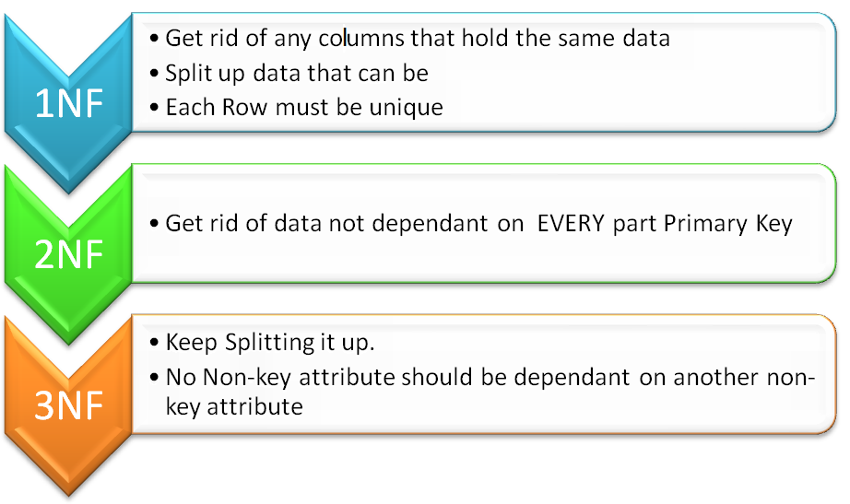

Slide 25


